Slide 1
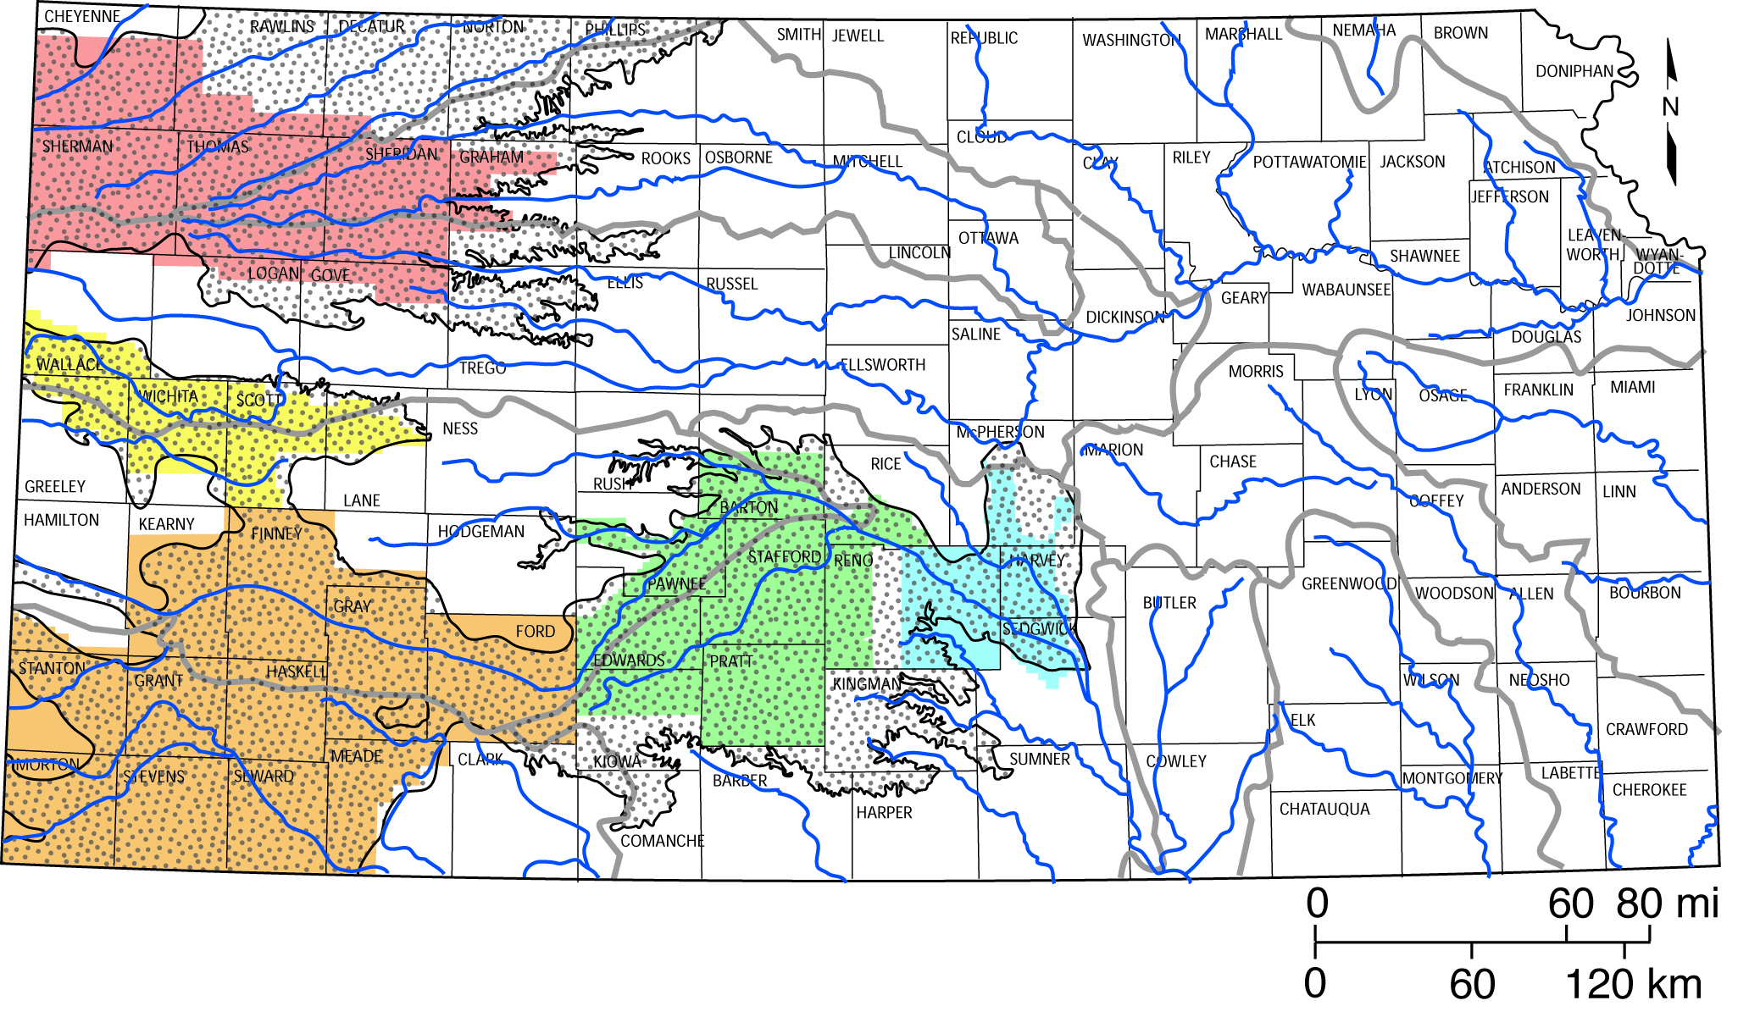
DEVELOPMENT OF THE KANSAS HIGH PLAINS AQUIFER MODELING FRAMEWORK
Kansas Geological Survey Modeling Team
October 21, 2015

Slide 2
Task 1: GMD2 MODELING
Sustainability Assessment
Nov 1, 2015 – Mar 31, 2016
Apply new KGS data-driven water-balance approach for estimating net inflow for sustainability assessment.
Groundwater Model Expansion and Update
Apr 1, 2016 – Oct 31, 2017
Expand model to include entire district and alluvial aquifer south of Wichita to Belle Plaine.
Update three-layer model to 2014 data.
Enhance model with hydrostratigraphy and new inflow approach.
Link model to existing GMD5 model.
Calibrate model (water levels, streamflow, assess sustainability).
Run future pumping scenarios.
Prepare model documentation.

Slide 3
Q_{stable} = 179. x 10³ ac-ft
Q_{average} = 182. x 10³ ac-ft

Slide 4
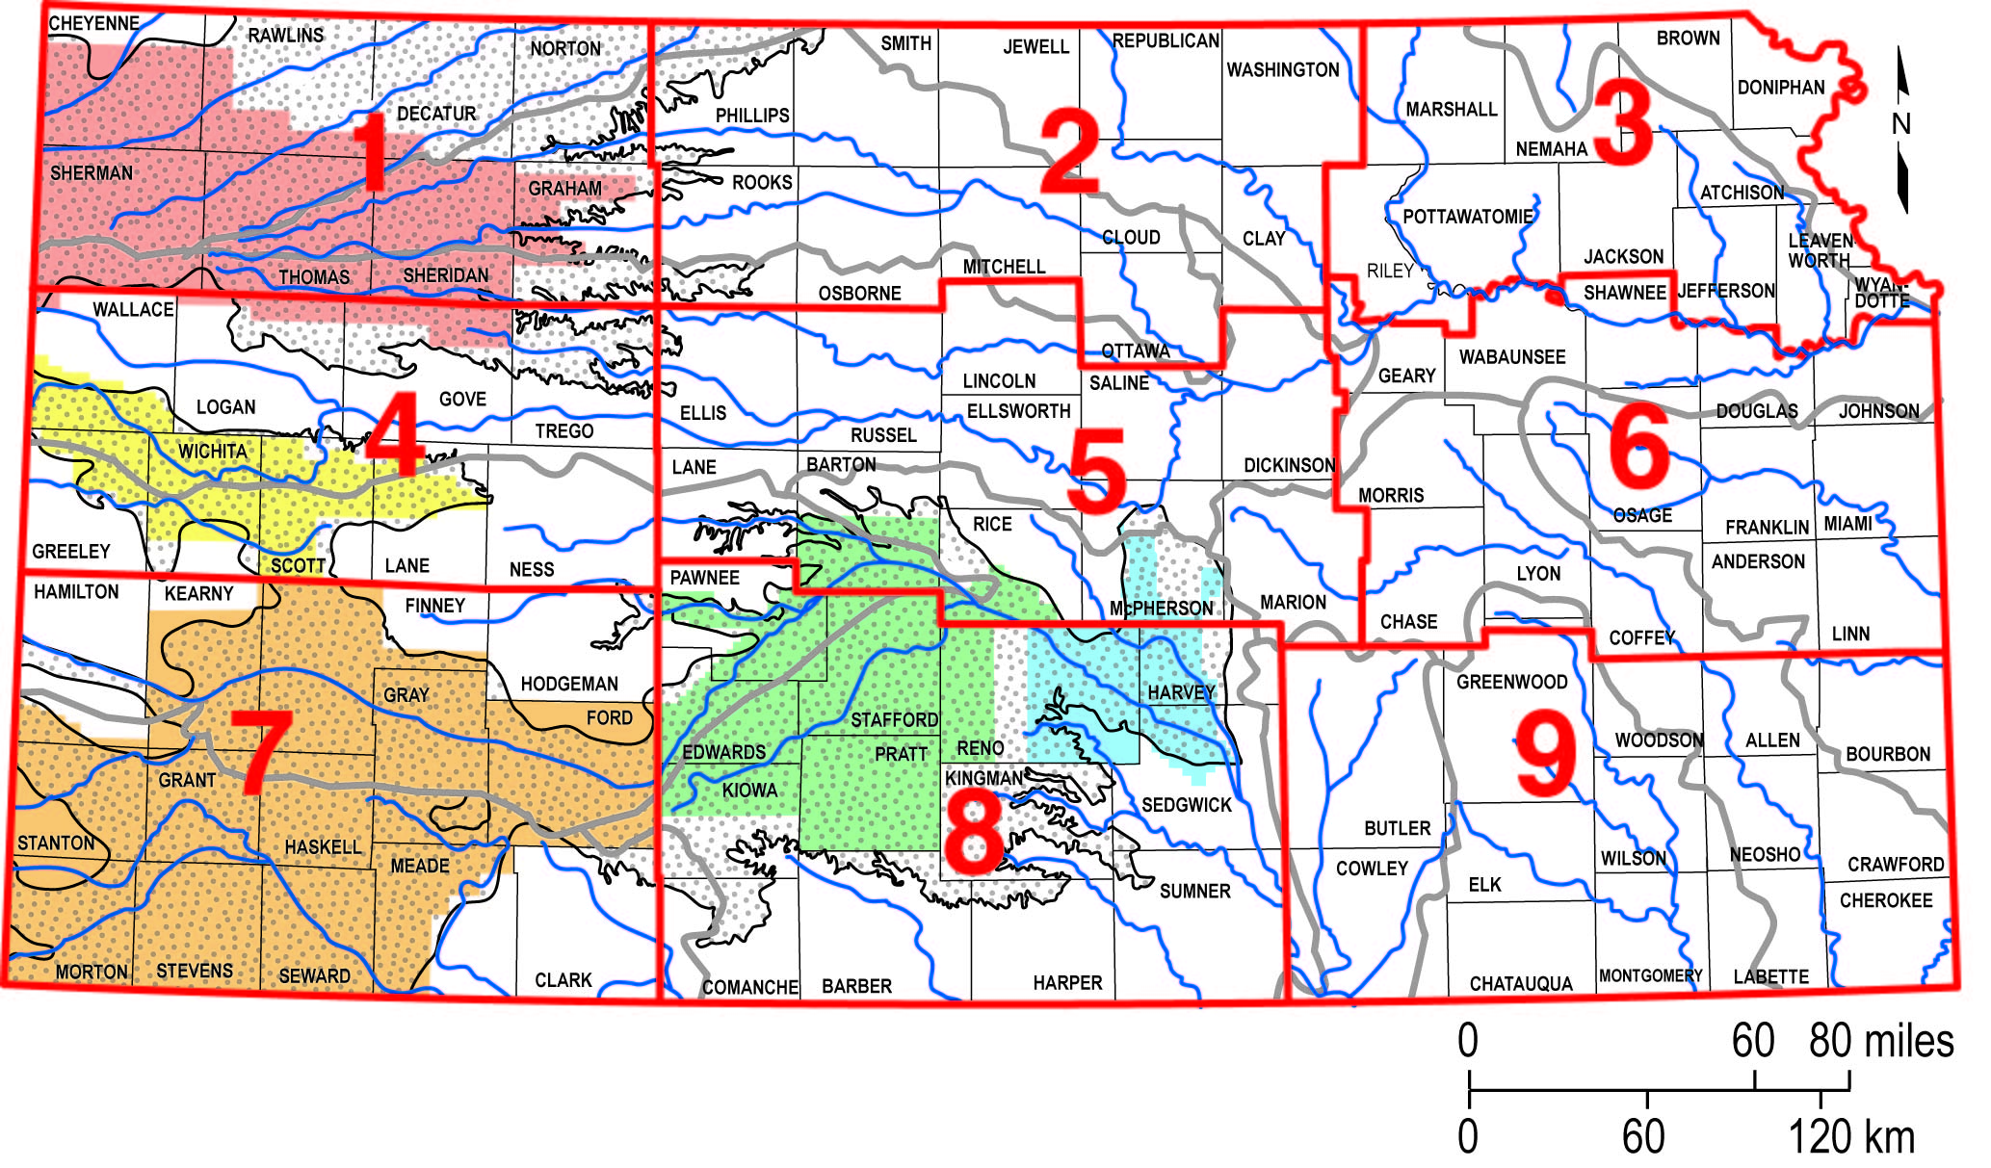
Climatic Divisions and
Groundwater Management Districts in Kansas
GMD4
GMD1
GMD5
GMD2
GMD3

Slide 6
Q_{stable} = 179. x 10³ ac-ft
Q_{average} = 182. x 10³ ac-ft
Q_{SPI=0} = 195. x 10³ ac-ft

Slide 7
Q_{stable} = 30.4 x 10³ ac-ft
Q_{av} = 31.8 x 10³ ac-ft
Q_{stable} = 48.0 x 10³ ac-ft
Q_{av} = 48.1 x 10³ ac-ft

Slide 10
Task 2: GMD4 MODELING
Nov 1, 2017 – Oct 31, 2019
Update model to 2016 data.
Enhance model with hydrostratigraphy.
Re-examine recharge representation.
Link model to existing GMD1 model if necessary along western buffer area in eastern Colorado.
Calibrate model (water levels, streamflow, assess sustainability).
Run future pumping scenarios.
Prepare model documentation.

Slide 11
Task 3: GMD3 MODELING
Nov 1, 2019 – Oct 31, 2020
Update model to 2018 data.
Re-examine recharge representation.
Link model to existing GMD1 and GMD5 models.
Calibrate model (water levels, streamflow, assess sustainability).
Run future pumping scenarios.
Prepare model documentation.

Slide 12
Task 4: HPA RESULTS ASSESSMENT
Nov 1, 2020 – Apr 30, 2021
Assessment of results from the entire Kansas High Plains aquifer modeling framework.

Slide 13
AQUIFER MODELING MAINTENANCE PROGRAM
(AMMP)
Program would consist of five-year segments.
Each year: Update one of the four KGS GMD models on a rotating basis.
Final year: Update linkages between models and assess results from entire Kansas High Plains aquifer modeling framework.

Slide 14
MODELING FRAMEWORK: TASK OVERVIEW
1. GMD2 Modeling
a. Sustainability Assessment
b. Groundwater Model Expansion and Update
2. GMD4 Groundwater Model Update and Enhancement
3. GMD3 Groundwater Model Update and Enhancement
4. Results Assessment for High Plains Aquifer Modeling
- - - - - - - - - - - -
Aquifer Modeling Maintenance Program Following Above

