Slide 1
State Association of Kansas Watersheds Annual Meeting
THE KANSAS DEPARTMENT OF AGRICULTURE
Division of Water Resources — Water Structures
January 30, 2024
Notes:
Please let us know if you would like to change this photo to fit your presentation.
We can easily do that.

Slide 2
Project Overview
The following areas were included in the evaluation:
Dam Permitting/Approval Process
Dam Inspection Process
Assessment of Risk
Compliance and Enforcement
Watershed District Act
Other Programmatic Challenges
Staffing and Funding
Staffing Adjustments for Recommended Enhancements

Slide 3
Project Approach
Compare the Dam Safety Program’s regulatory program and processes to other states, national averages and industry standards.
Interviews with Program Staff
Interviews with other states’ Dam Safety Program Representatives
Alabama, Arizona, California, Colorado, Connecticut, Georgia, Mississippi, Missouri, Nebraska, Ohio, Oklahoma, Pennsylvania, Tennessee, Texas, Utah, Vermont, Virginia
Review publications and industry standards
ASDSO publications
NRCS publications
US Fish and Wildlife publications
USACE publications

Slide 4
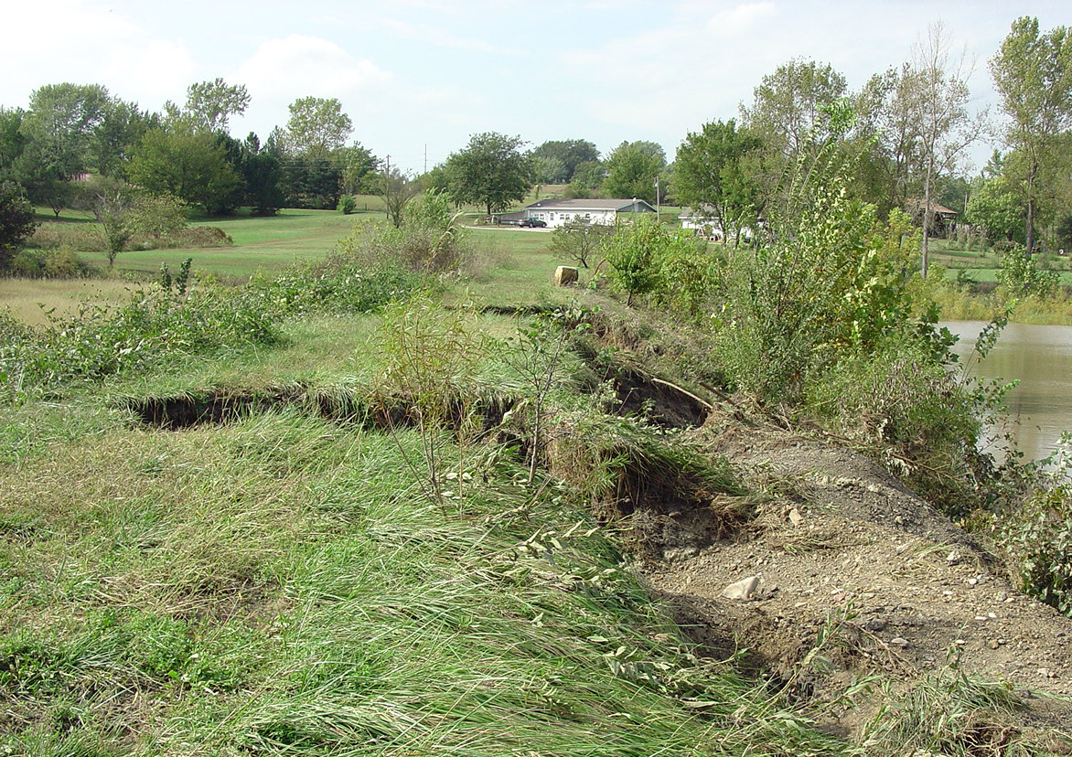
Dam Inspections
Return to agency-conducted safety inspections.
Maintain 3-year rotation for High Hazard Potential Dams.
Maintain 5-year rotation for Significant Hazard Potential Dams.
Inspect Low Hazard Potential Dams on a 10-year rotation.

Slide 5
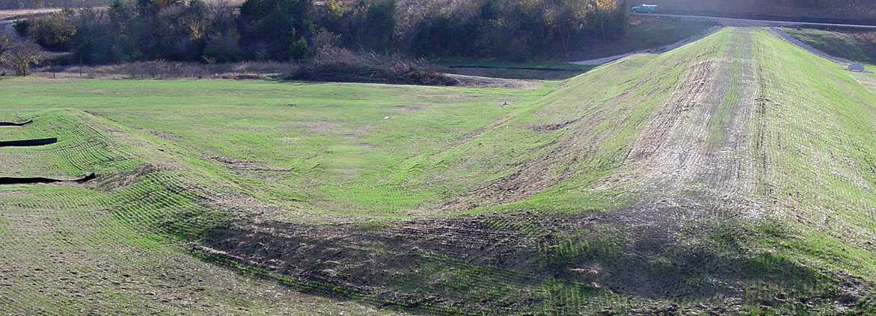
Application Fees
Need to increase application fees to support the services provided.
High Hazard Potential Dam — $5,000 New / $3,000 Modification
Significant Hazard Potential Dam — $3,000 New / $2,000 Modification
Low Hazard Potential Dam — $1,500 New / $1,000 Modification

Slide 6
Registration Fees
Registration fees are needed to support the services provided.
High Hazard Potential Dam — $1,500 / year
Significant Hazard Potential Dam — $1,000 / year
Capped at $10,000 / year / owner.

Slide 7
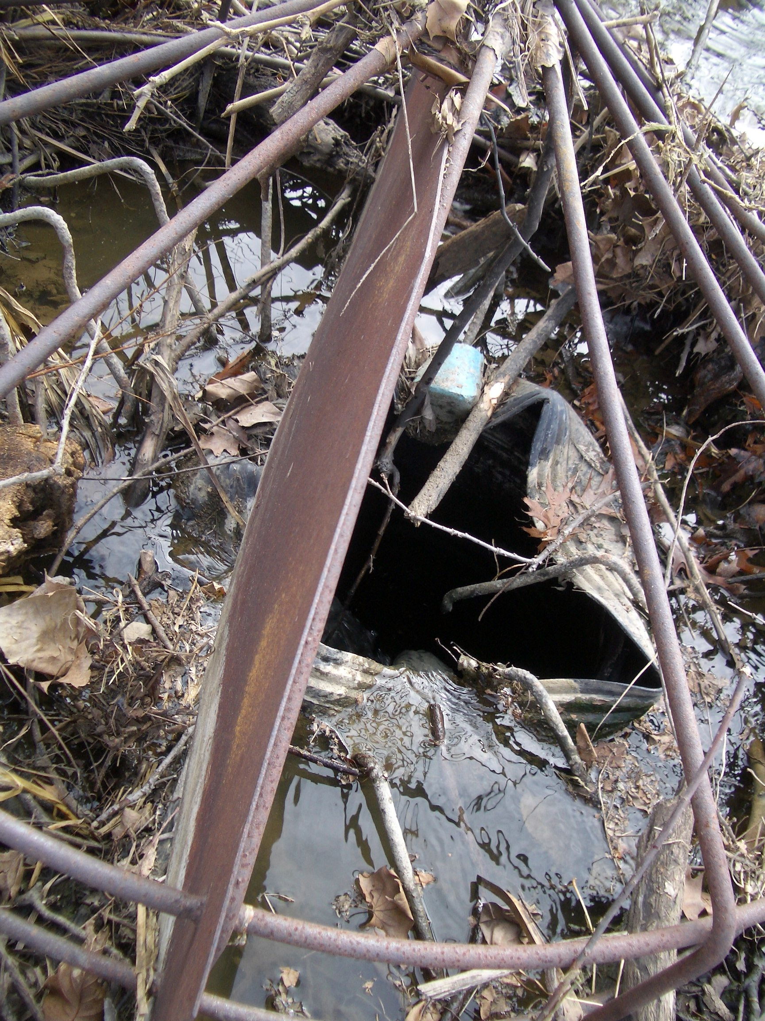
Compliance and Enforcement
Ability to assess civil penalties for dams and stream obstructions for non-compliance with regulations.
Use risk-informed decision making to prioritize enforcement actions.

Slide 8
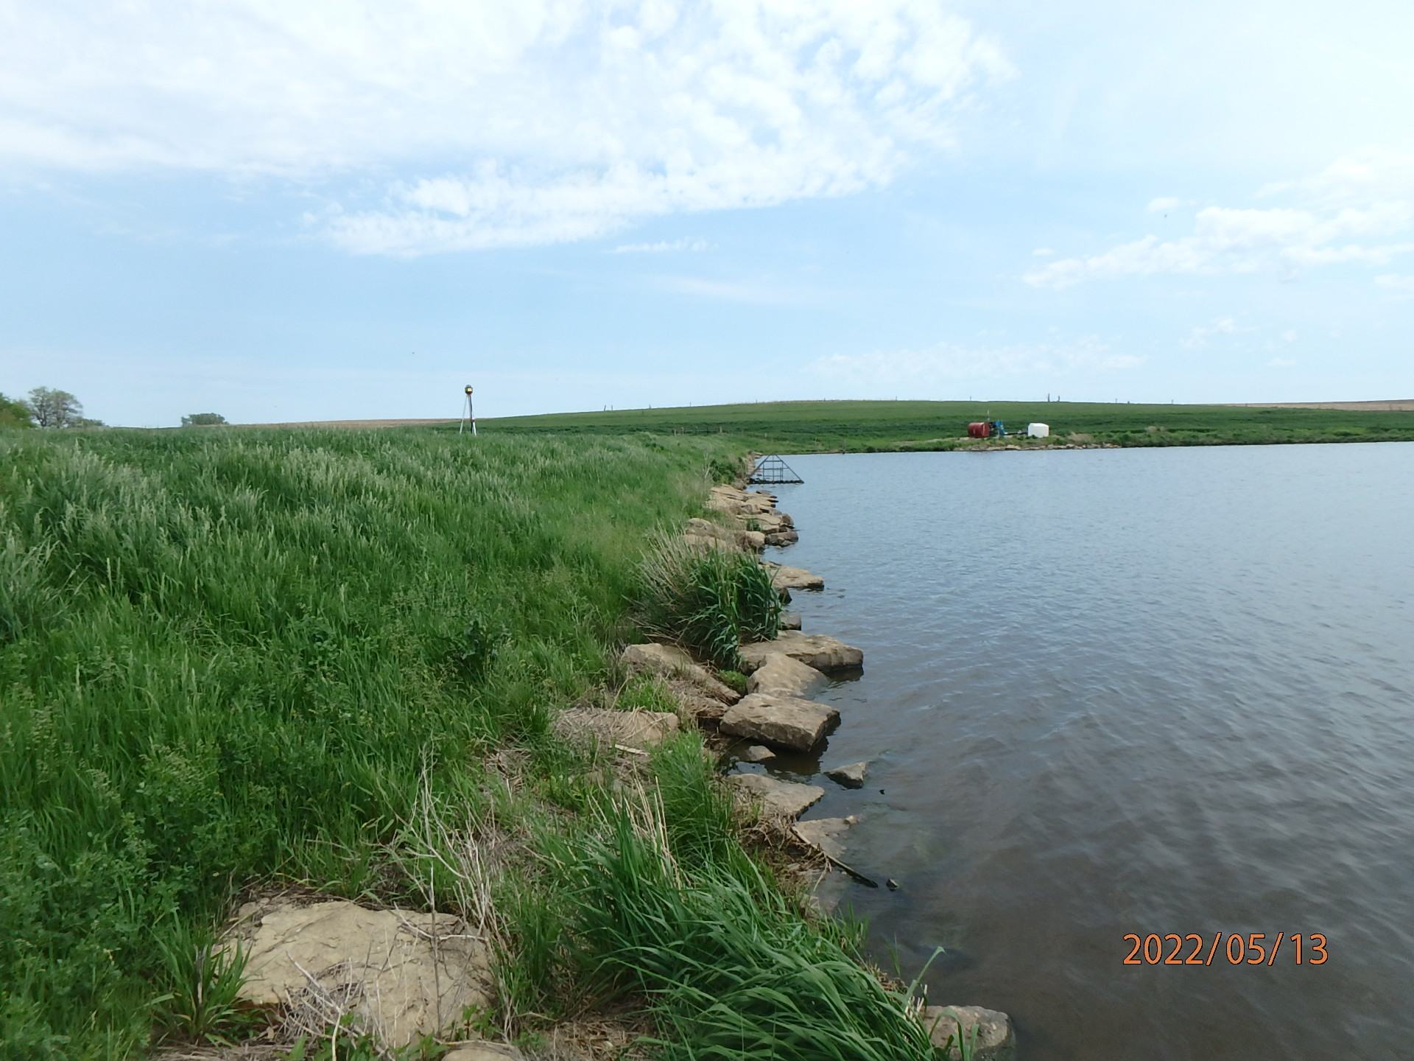
Class A Exemptions
Remove Class A exemption for a dam that has a height of less than 30 feet and a storage volume of less than 125 acre-feet at the auxiliary spillway.
Maintain the exemption for confined feeding facilities.

Slide 9
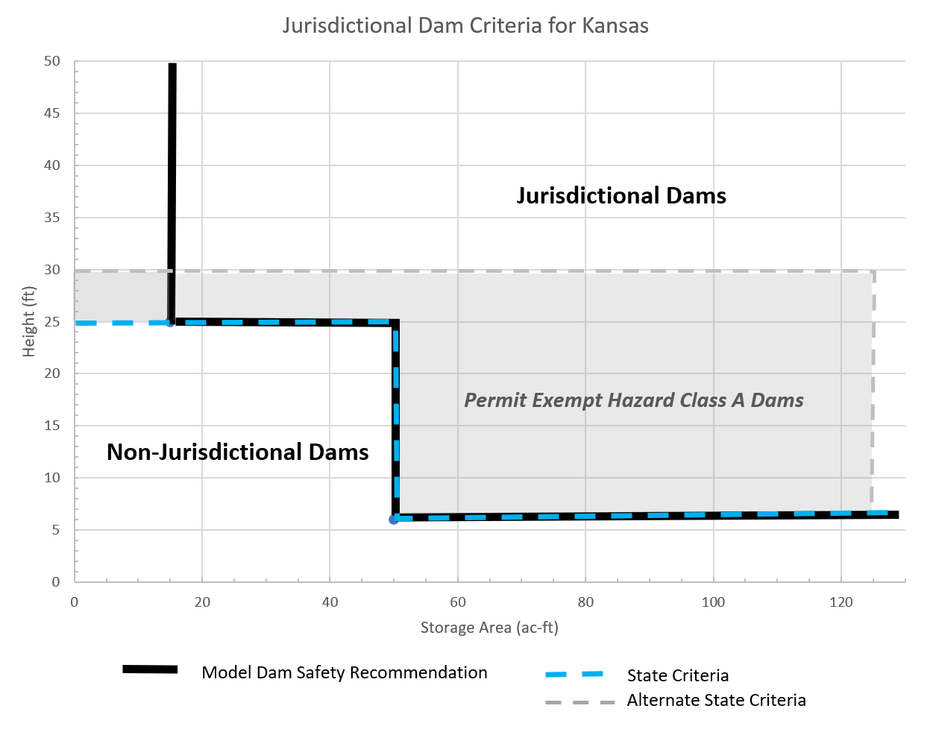
Definitions and Flexibility
Definition of a Dam (regulated dam)
Remove permit exemption for hazard class A dams

Slide 10
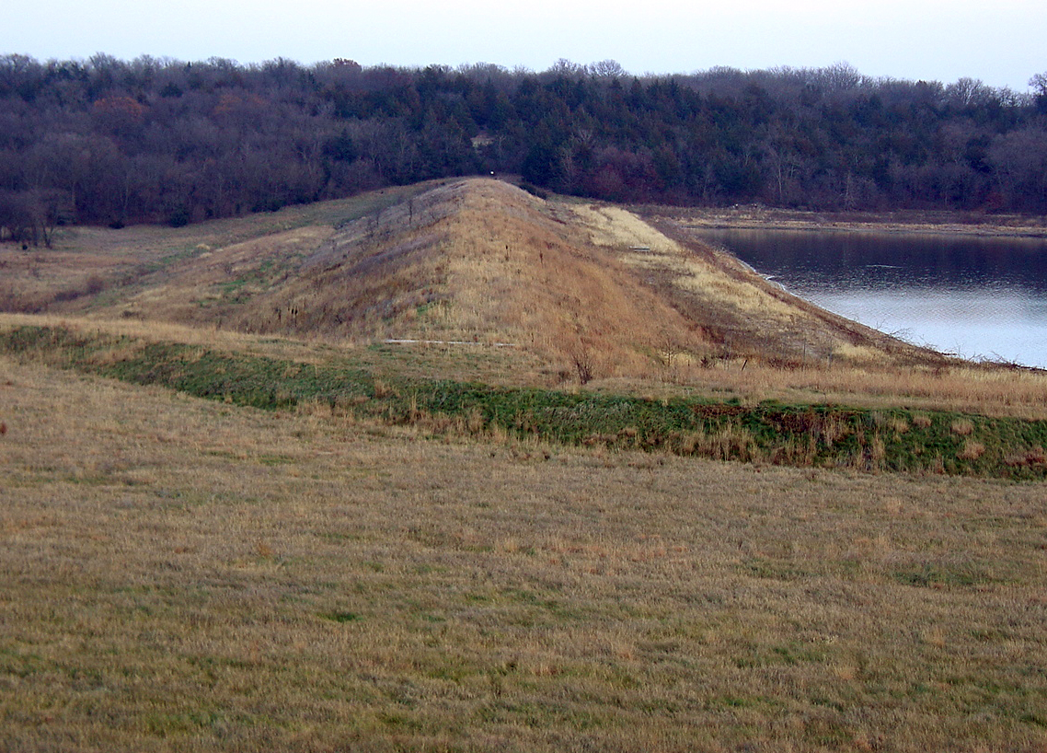
Staffing
Kansas ranks 49th of the 50 state dam safety programs on the number of dams per Full Time Equivalent (FTE).
To perform existing services and proposed inspections, we would need 16 FTEs.

Slide 11
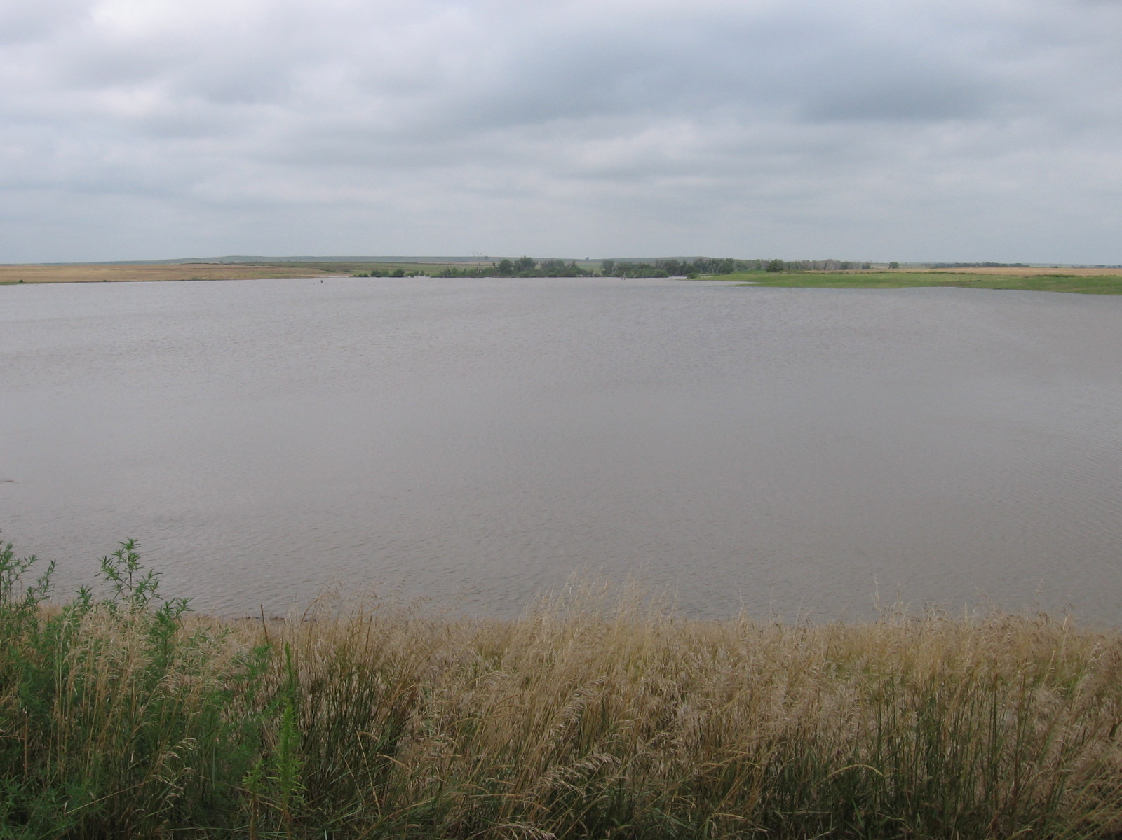
Watershed District Act
Regulations are needed to clarify requirements of the Act.

Slide 12
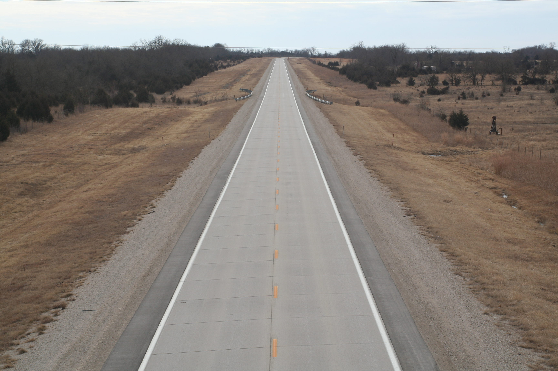
Other Recommendations Not Included in the Evaluation
Road fill dry detention exemption.
Exempt state, county, or municipal dry detention road fill dams from dam requirements.
Permit as stream obstruction.

Slide 13
Potential Regulatory Changes
Use Risk Informed Decision Making to define “Unsafe Dam” in regulations or guidance
Added flexibility for modifications and repairs
Modify K.A.R 5-40-76 (Repair or modification of a permitted dam shall meet the statutes and regulations in effect when the application for repair or modification is filed.)
Move non-safety standard design criteria to guidance

Slide 14
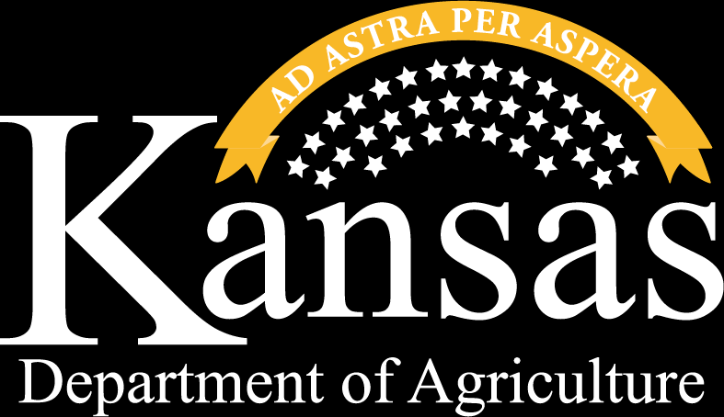
THANK YOU
Earl Lewis, P.E.
Chief Engineer Earl.Lewis@ks.gov
Terry Medley, P.E.
Water Structures
Program Manager Terry.Medley@ks.gov
Ambrose Ketter, P.E.
Dam Safety, Team Leader Ambrose.Ketter@ks.gov

